Slide 1
TITLE OF SERDP PROJECT
Your briefing will not be longer than 30 minutes
Do not use font smaller than 18
Project Number
Principal Investigator
PI’s Organization
In-Progress Review Meeting
DATE

Slide 2
XX-XXXX: Project Title
Performers:
Technology Focus
Summarize technology or methodology being studied or developed
Research Objectives
Summarize research objectives and criteria for success
Project Progress and Results
Describe significant progress, results, and/or concerns to date
Technology Transition
Identify the next steps in the development of the technology following the conclusion of the project. Include any planned outreach efforts to potential end-users
Representative graphics and logos.
Notes:
This project summary should be limited to one slide and should be presented in 2-3 minutes.

Slide 3
Project Funding (Example)
 | FY13* | FY14* | FY15* | FY16 | Total
Proposal Requested ($K) | 300 | 300 | 300 | 0 | 900
Funds Received ($K) | 300 | 0
% Expended | 60 | -
Projected Out-Year Funds Required ($K) |  | 200 | 300 | 100 | 900
Funding Issues:
Notes:
*NOTES:
This table should reflect SERDP funds sent to all directly funded and second tier performers working on the project.
Include columns for all fiscal years for which funding has been received, is budgeted to be received, or is proposed to be received in the Revised Funding Profile. Add columns as needed.
Based on your spend rates for funding already received and any discussion with your program manager, identify your proposed out-year funding requirements. Total should not exceed current total project value.

Slide 4
Project Team
This slide should list the names of the PI and co-performer(s), and their organization(s).
If there are no co-performers on the project, this slide is not required.
Notes:
Throughout this briefing/presentation template, suggestions are provided as to the number of slides that can be used to address a particular section of the brief. Regardless of the number of slides you ultimately use, plan the brief so that it can be delivered in no more than 30 minutes uninterrupted (not including backup slides).

Slide 5
Technical Objective
Briefly describe the technical objective(s) of your project.
Notes:
1. Limit to one slide only.
2. This section is meant to orient the review committee on the overall objectives of the research, regardless of what portion of the planned work was accomplished since project inception or the previous IPR, whichever is applicable.

Slide 6
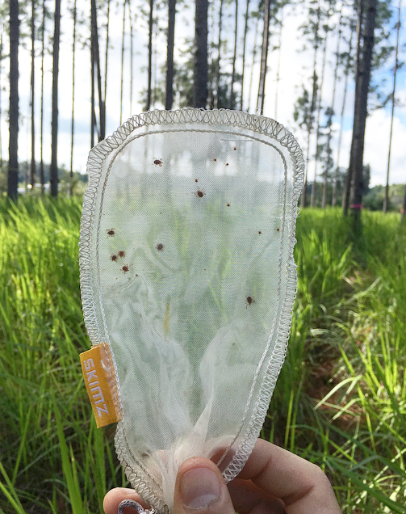
Technical Approach 2.4: Tick Survival Assay
Do invasive dominated communities increase tick survival?
Is survival due to alterations of microclimatic conditions?
How do these dynamics differ by life stage?
Checking survival of adult and nymph ticks in a survival assay
Notes:
This section may encompass several (3-6) slides.
Use of visuals in addition to text is strongly encouraged.
Convert to one question (paired plots)
Label uner photo

Slide 7
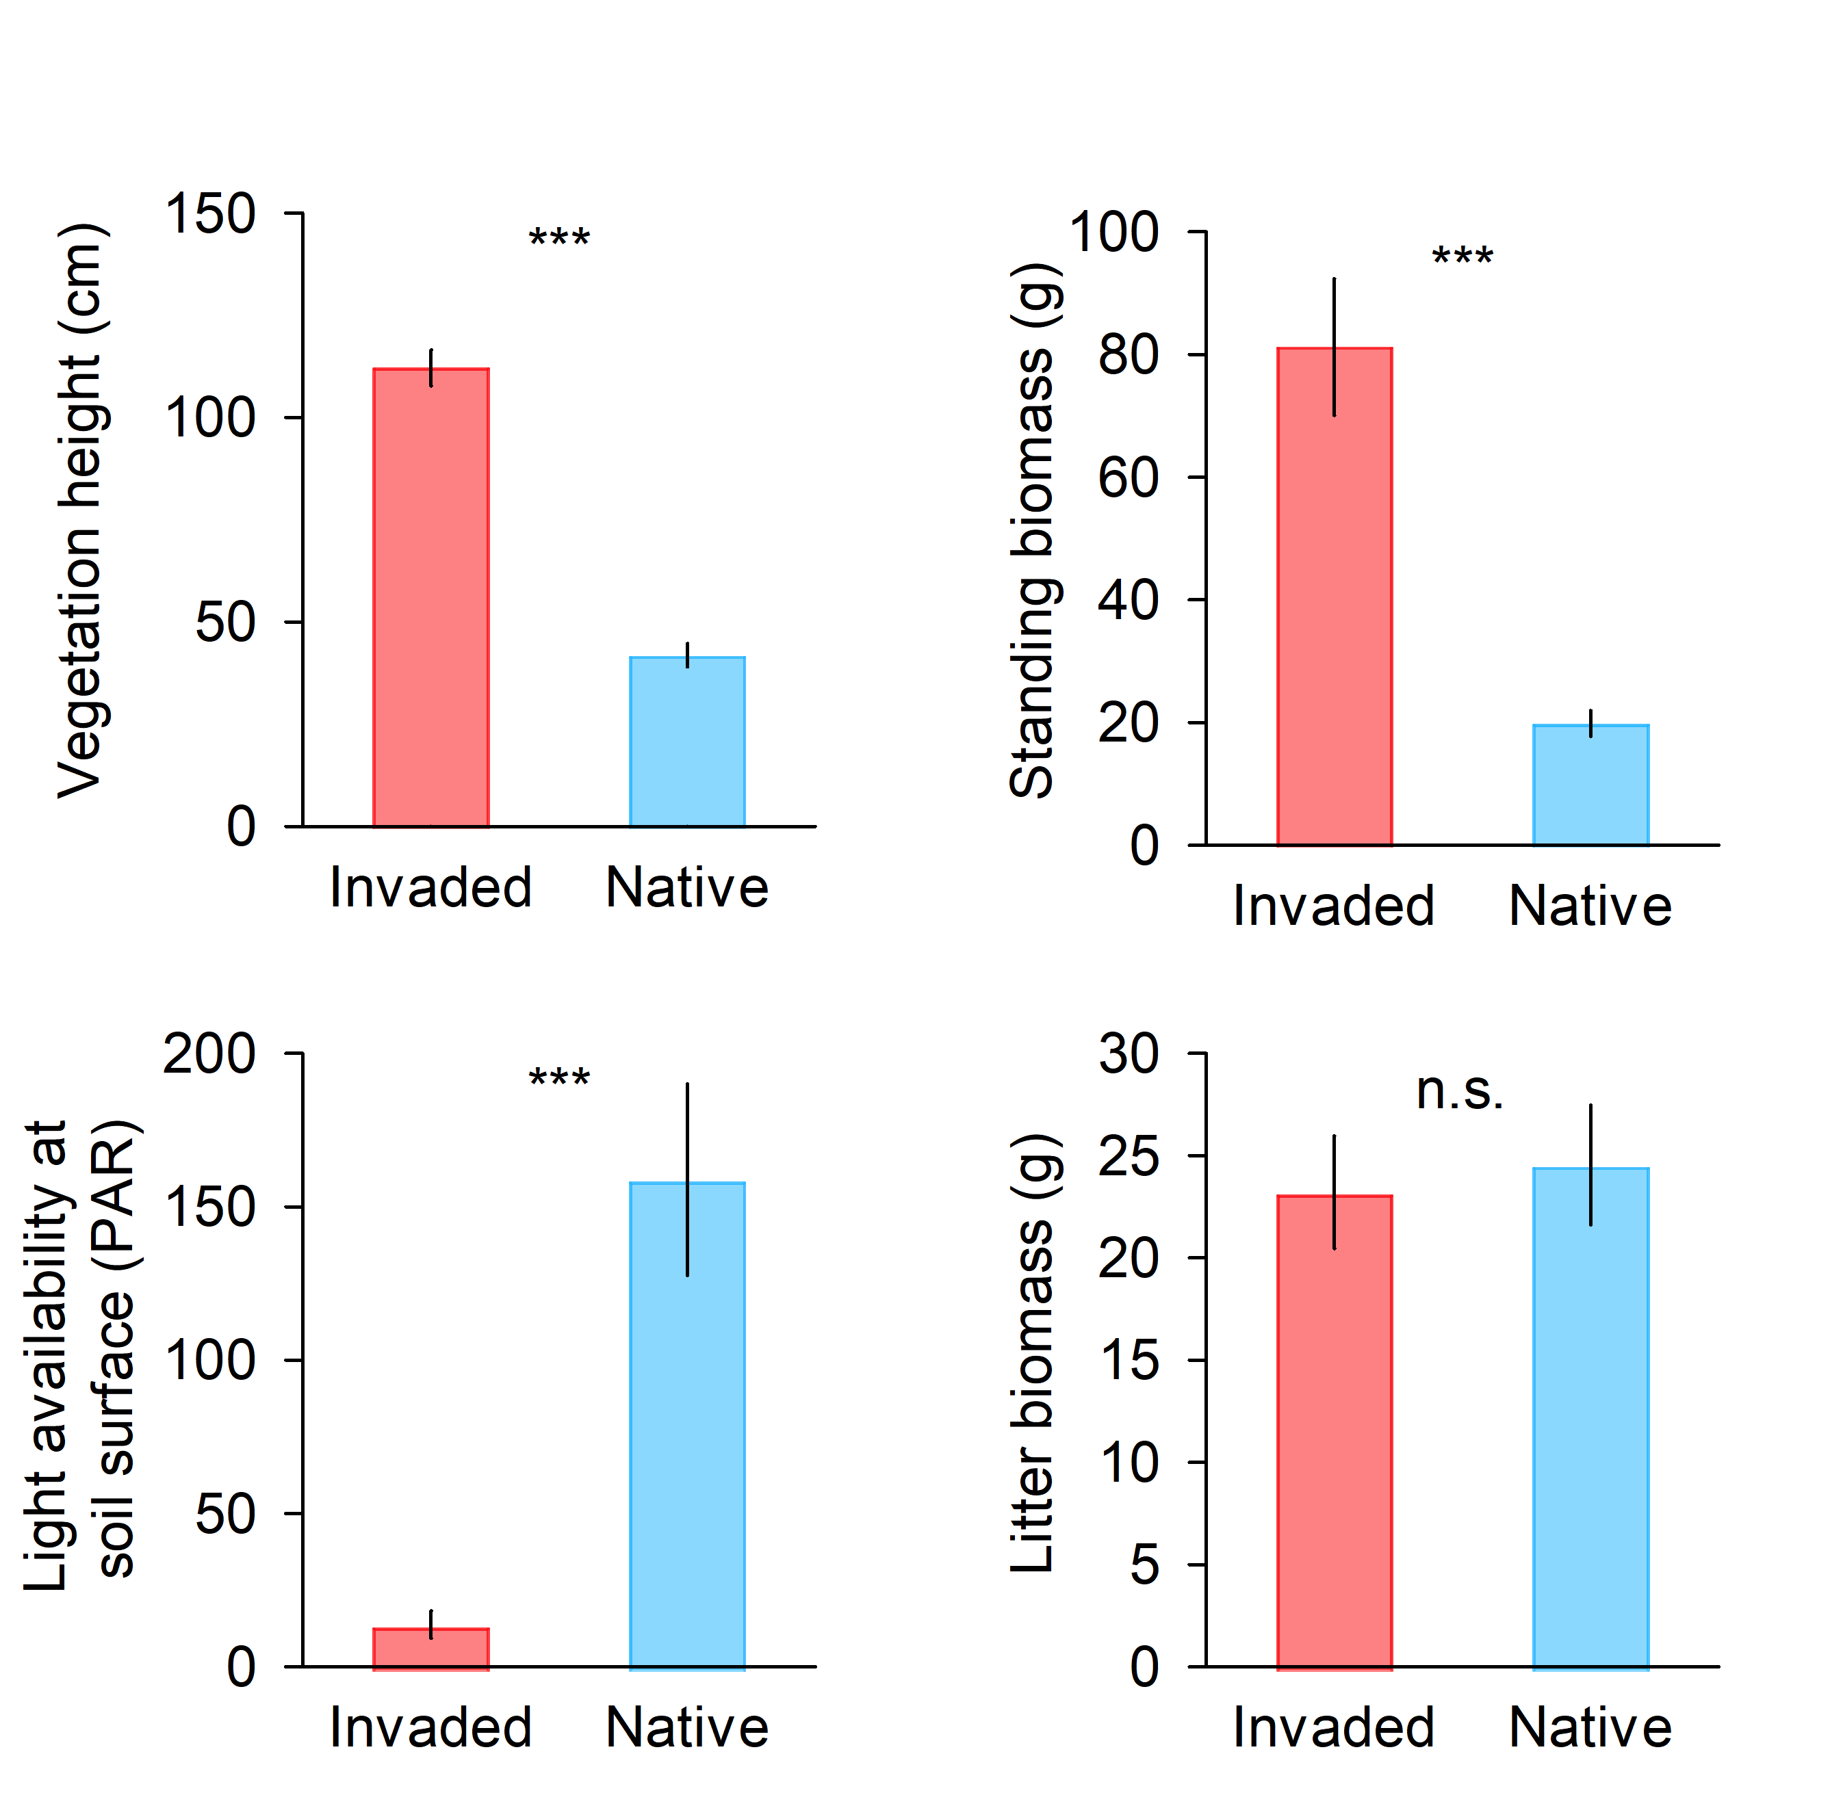
Results (Objective 2.4) Tick Survival Assay
Cogongrass alters structure of understory plant community

Slide 8
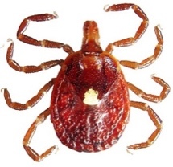
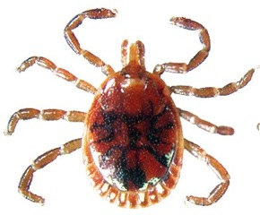
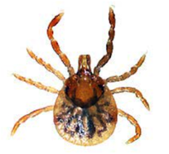
Results (Objective 2.4) Tick Survival Assay
Cogongrass invaded plots increase tick survival (52% adults, 57% nymphs)
Adult Female
Adult Male
Nymph
Time (days)
Notes:
Nothing in this section should have been presented at previous IPRs
This section should encompass several (3 to 4) slides, with go/no-go information, if applicable, on a separate slide.
The use of graphics/pictures/graphs/tables is strongly encouraged. Ensure font size on graphics/tables/graphs is large enough to be easily read by the audience and include captions, table headings, axis labels, or legends as applicable.
Ensure that any analytical results are accompanied by a description of appropriate statistical analyses.
This section is expected to make up the majority of your presentation.

Slide 9
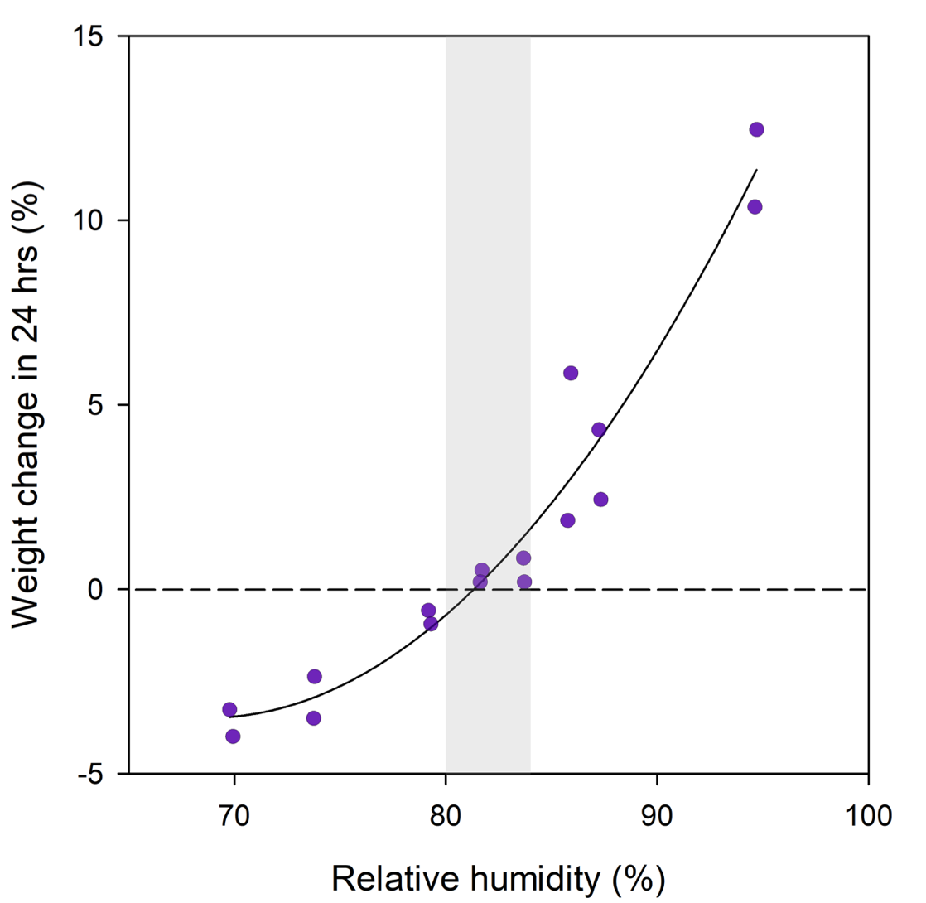
Results (Objective 2.4) Tick Survival Assay
Cogongrass invaded plots buffer harsh microclimate conditions, creating a microclimate that limits tick desiccation
Equilibrium
Gain water
Native
Lose water
Invaded
Redrawn from Hair et al. (1975)

Slide 10
Results (Objective 2.4) Tick Survival Assay
Cogongrass invaded plots buffer harsh microclimate conditions, creating a microclimate that limits tick desiccation
Native
Equilibrium
Invaded
Gain water
Lose water

Slide 11
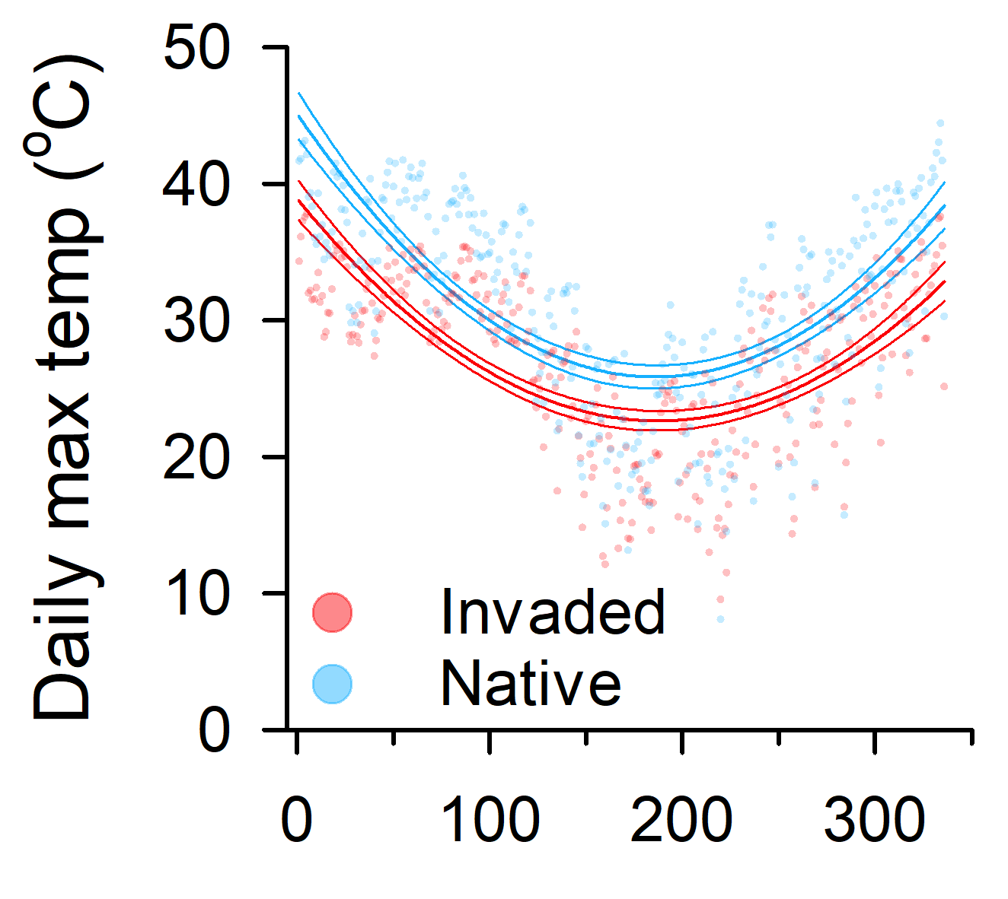
Results (Objective 2.4) Tick Survival Assay
Cogongrass invaded plots buffer harsh microclimate conditions, creating a microclimate that limits tick desiccation
Maximum Temperature
Effect | Wald χ² | P
Treatment | 10.17 | 0.002
Stage | 64.48 | < 0.001
Trt*Stage | 27.10 | < 0.001
Max Temp | 23.70 | < 0.001
Time (days)
Notes:
We ran these model including RH covariates and they did not come out significant in the model. What we are thinking is that treatment is washing out any other signal that we might see from the relative humidity covariates. Perhaps, because we see a rather consistent difference in relative humidity between treatments, that the difference in drying (VPD) is driven more strongly by the differences in maximum temperature.

Slide 12
Technical Approach 2.5: 2019 Fieldwork
How do cogongrass invasions affect host use and tick abundance?
Are differences in microclimate between invaded and uninvaded areas consistent across a broad geographical area?

Slide 13
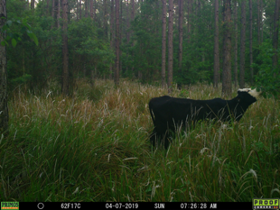
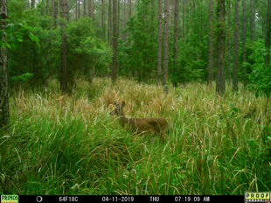
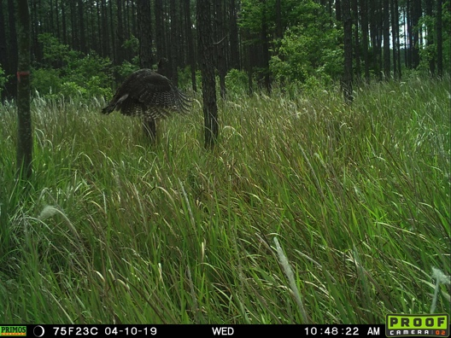
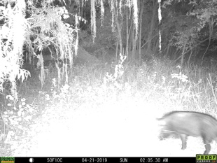
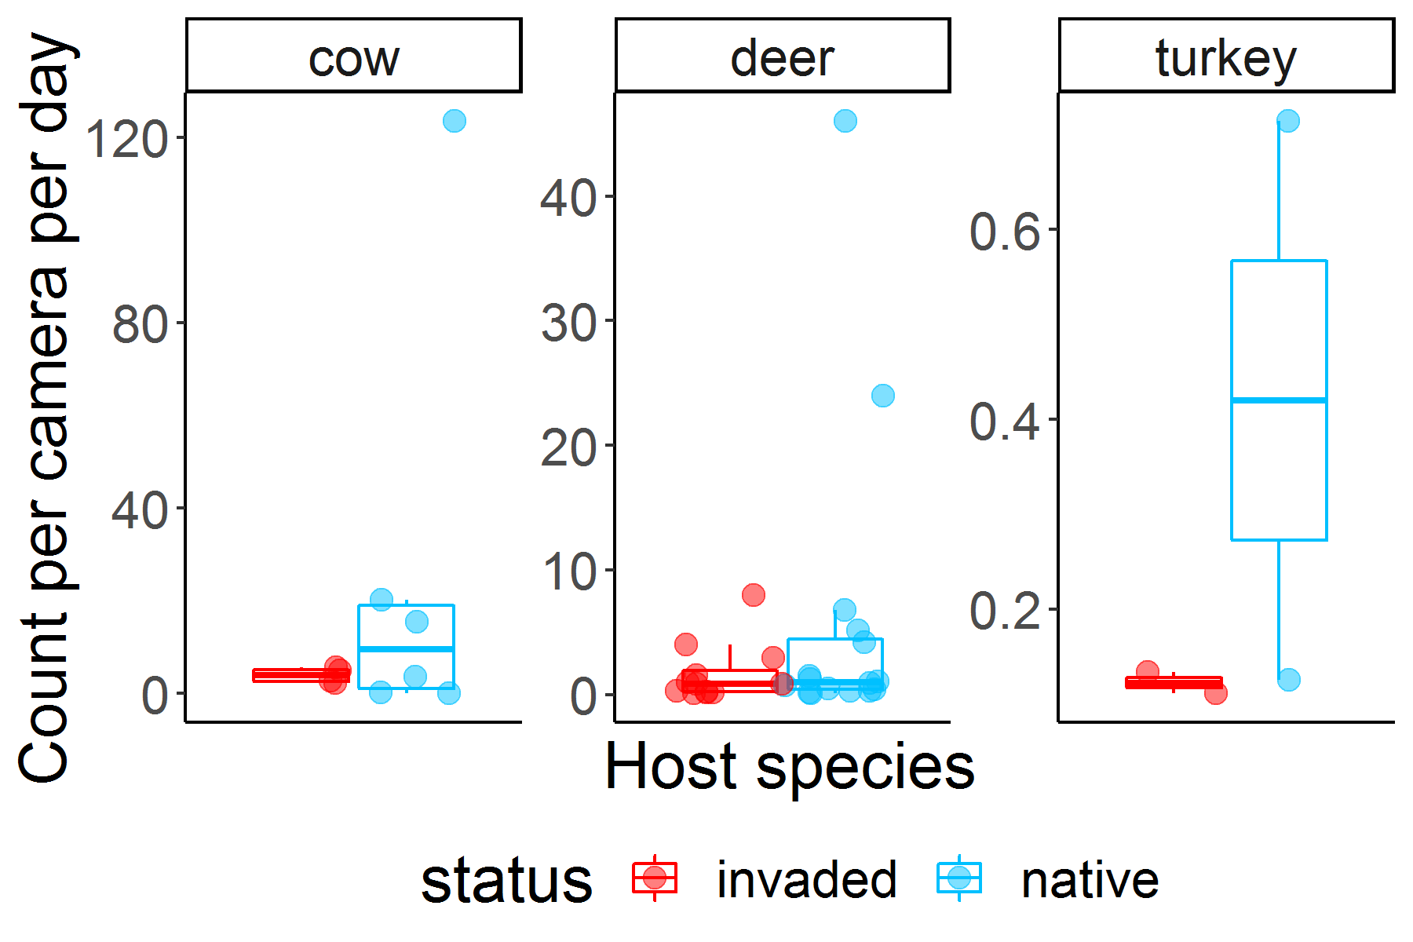
Results (Objective 2.5) 2019 Field data
Host use in invaded and native plots, photos show the variety of hosts the use cogongrass dominated areas.

Slide 14
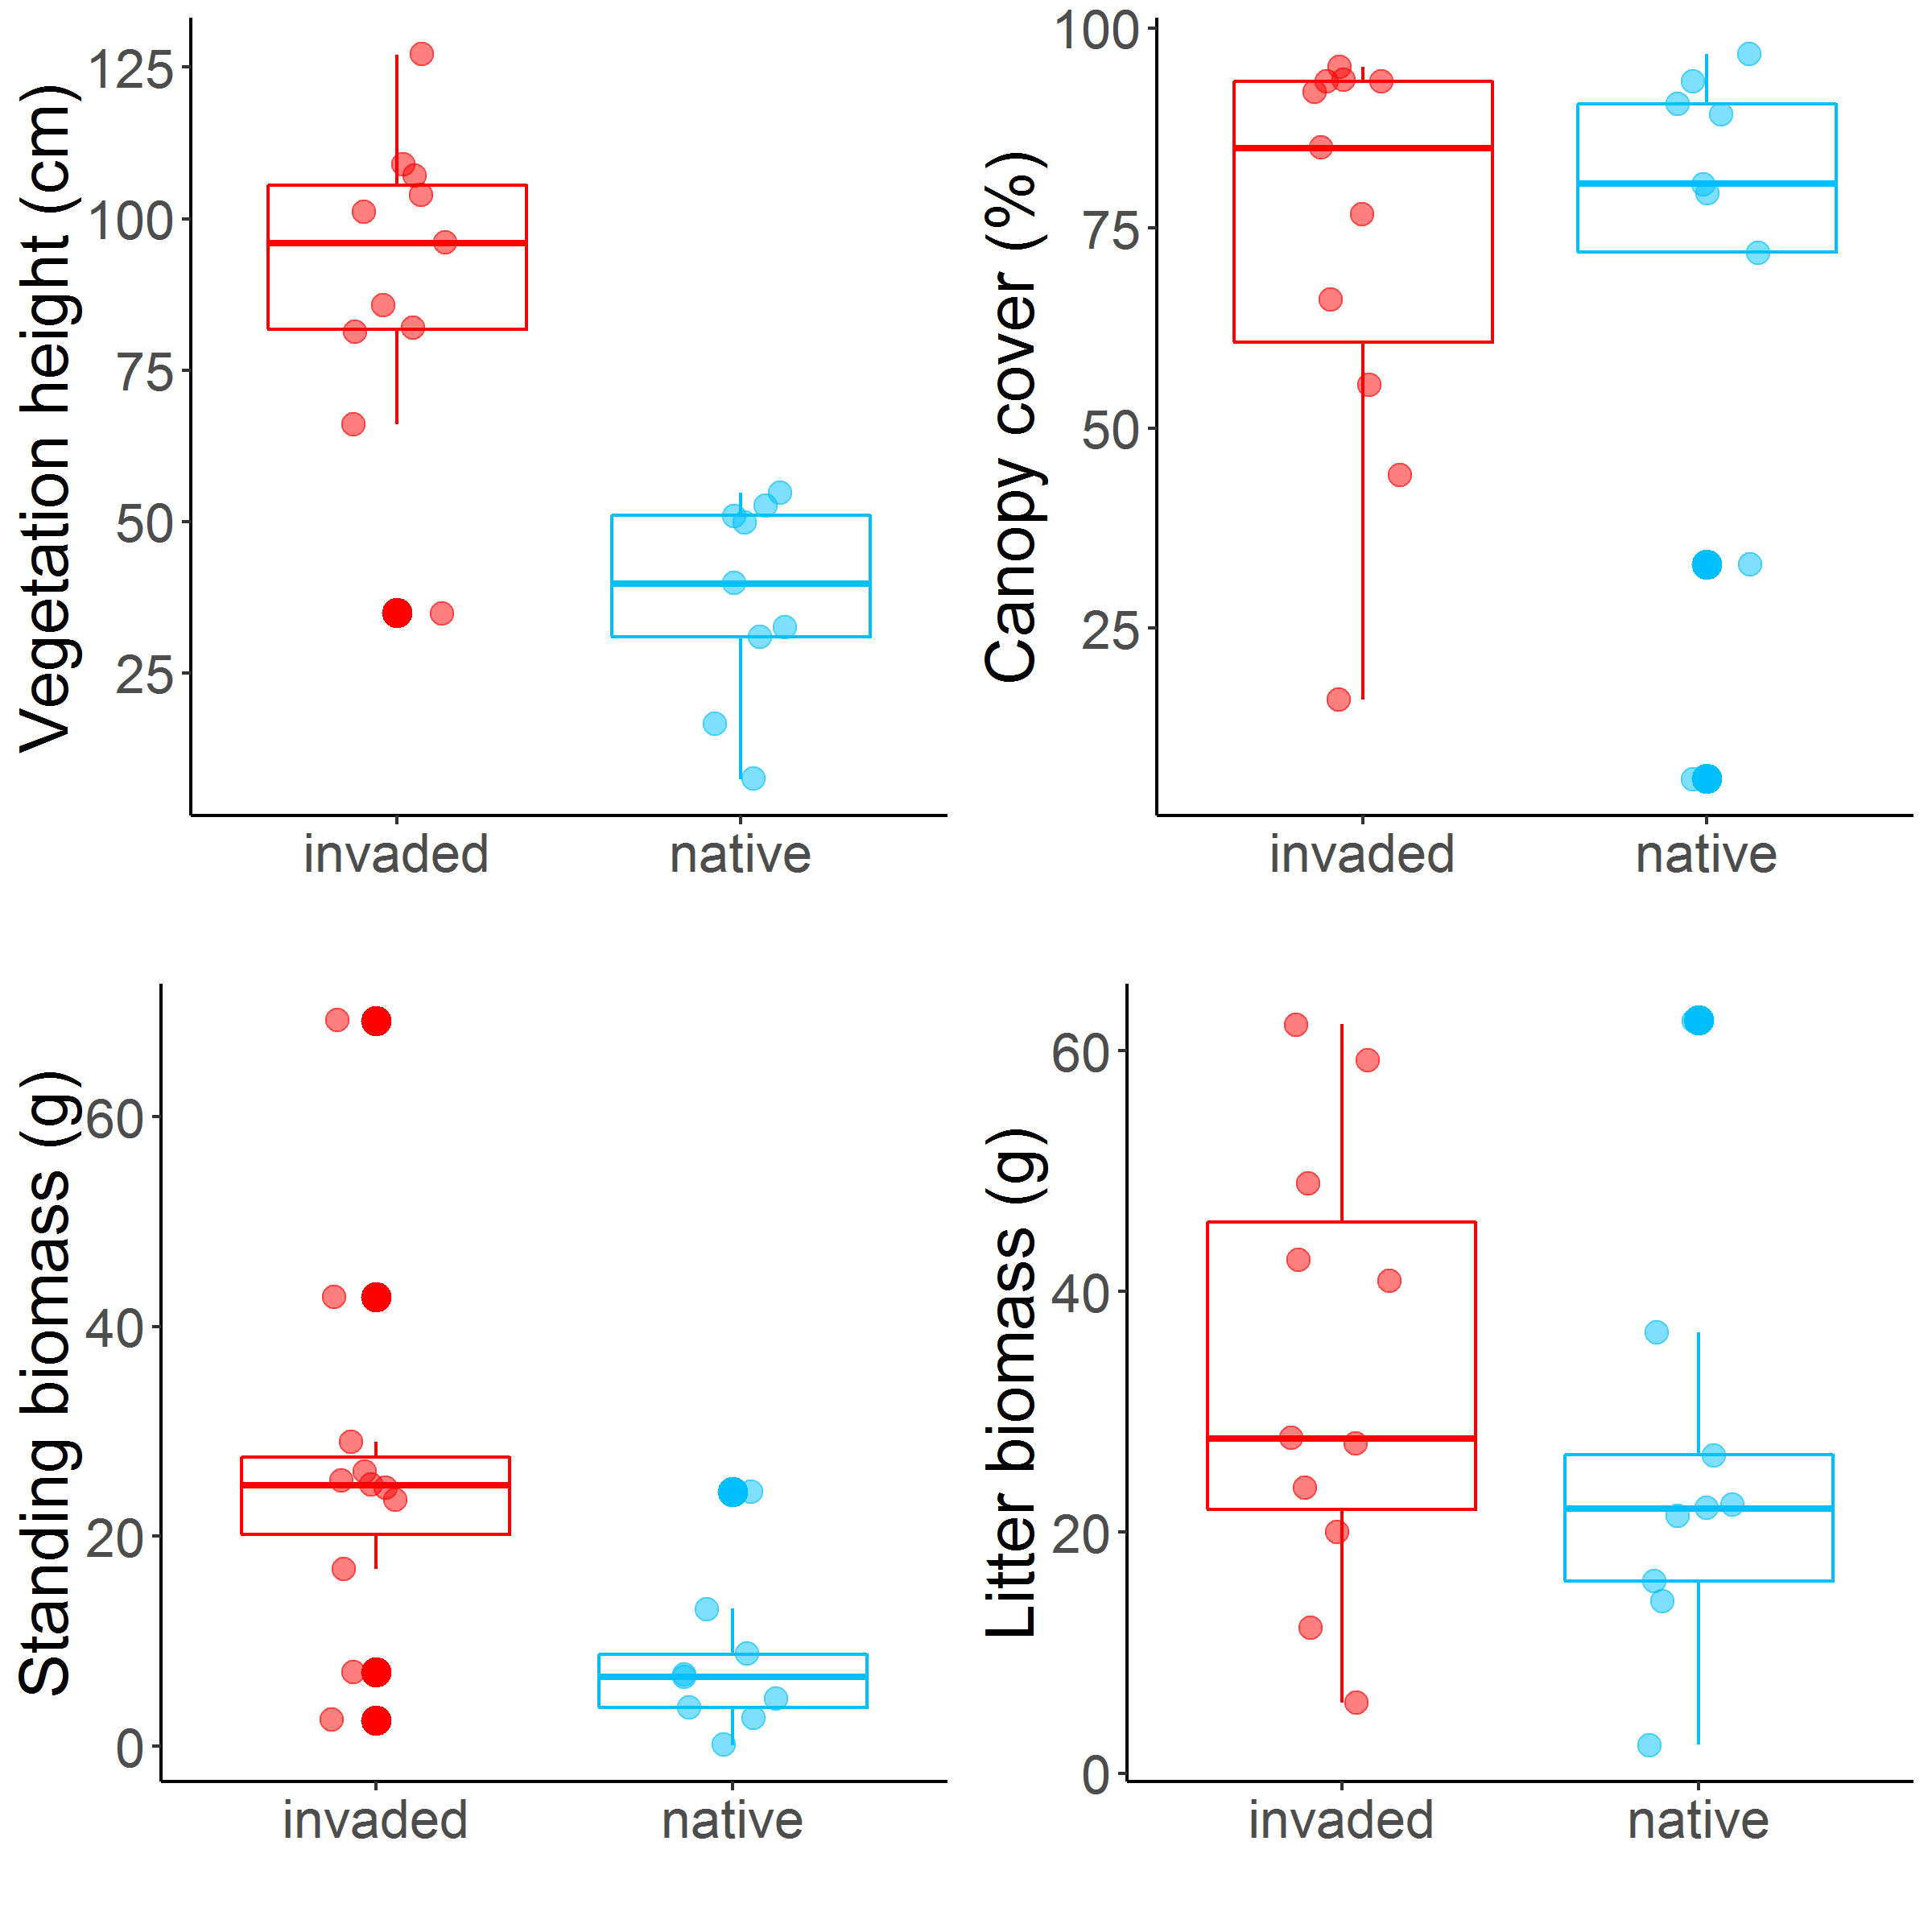
Results (Objective 2.5) 2019 Field data
2019 field plots have similar conditions to the site where the tick survival assay was conducted
Notes:
Canopy cover is over story (tree) canopy cover.

Slide 15
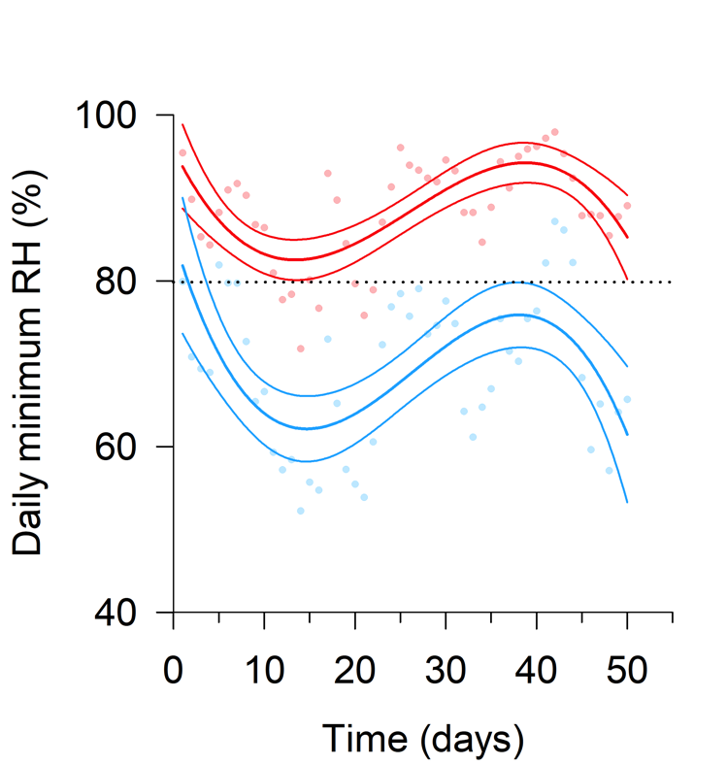
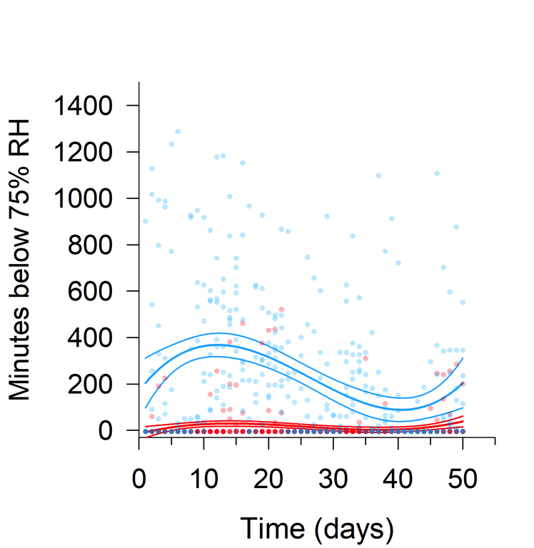
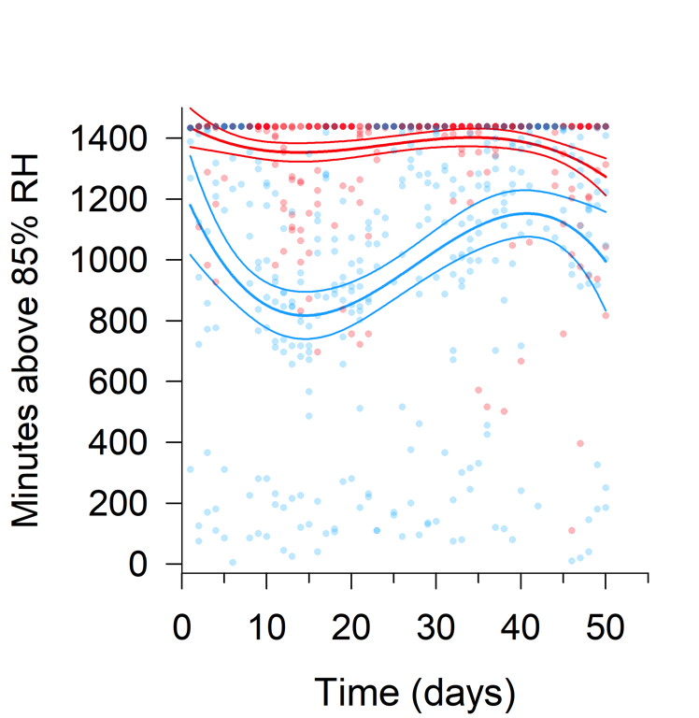
Results (Objective 2.5) 2019 Field data
June 12
Aug 2
June 21
May 23
Notes:
Comparison of 2019 temp/RH data throughout Florida shows similar patterns to our TSA at one location in North Central Florida.

Slide 16
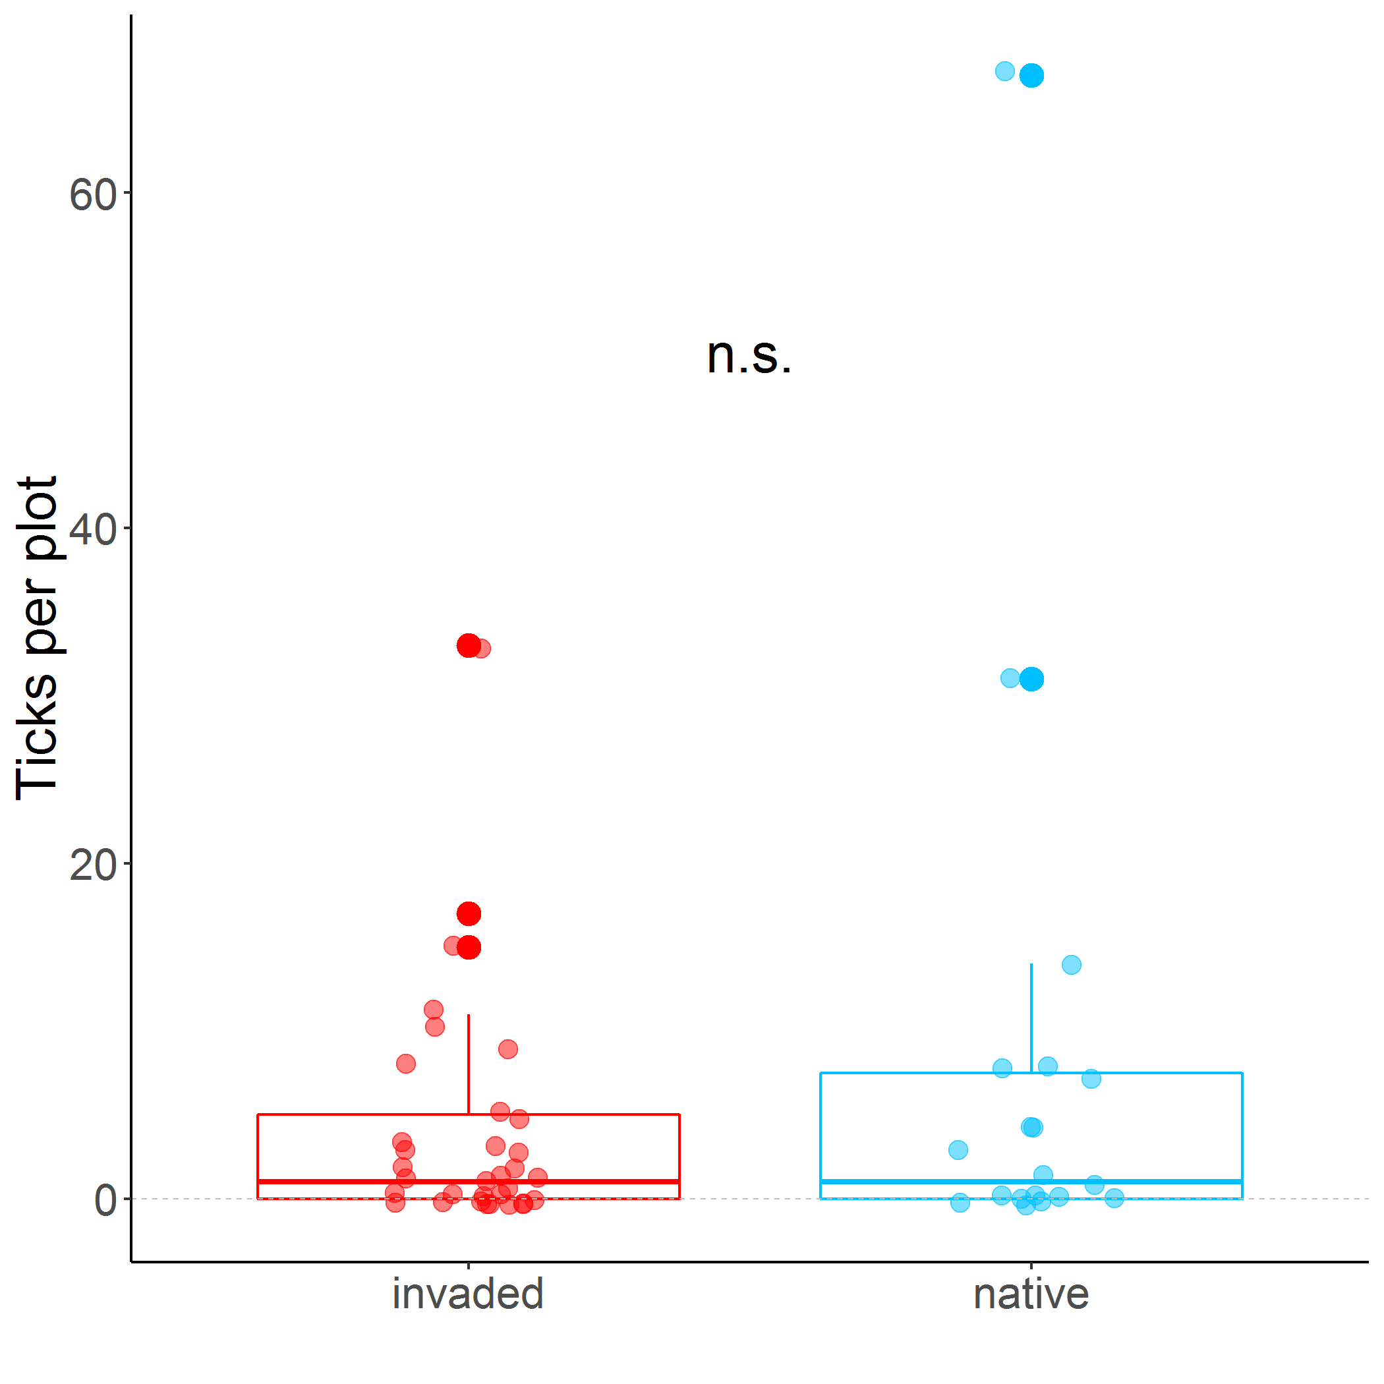
Results (Objective 2.5) 2019 Field data
Cogongrass invaded plots maintain similar tick abundances primarily through an increase in tick survival rather than through increased host use.
Notes:
Highlight + -

Slide 17
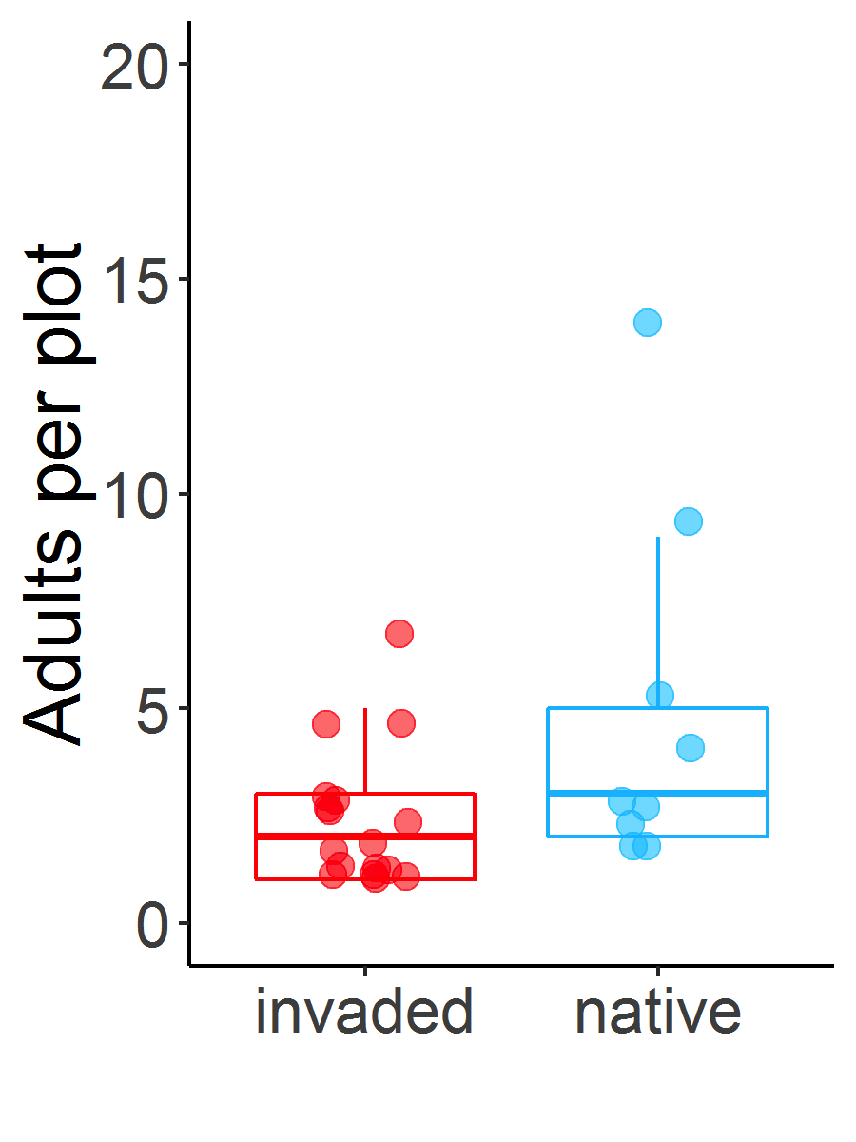
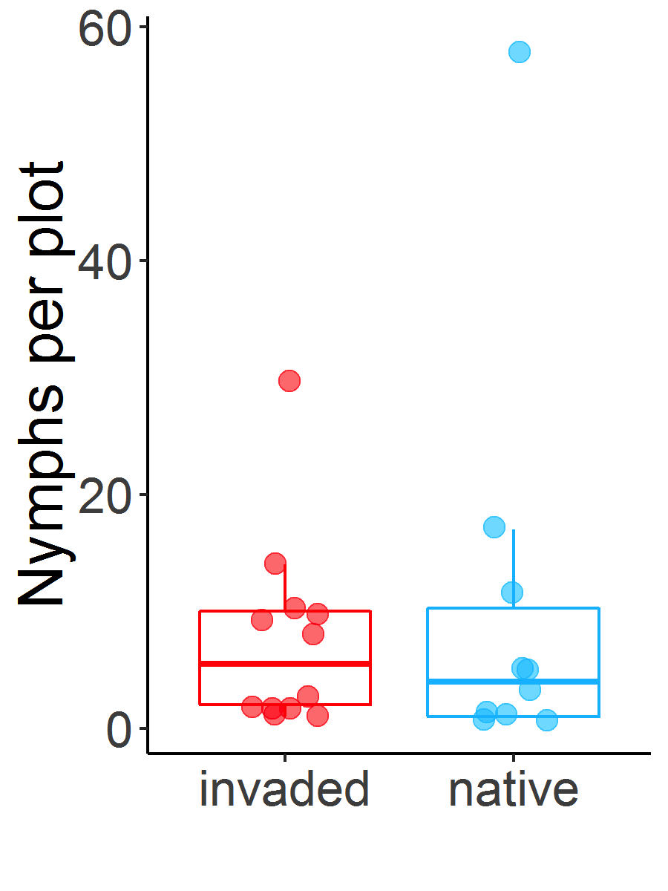
Results (Objective 2.5) 2019 Field data
Notes:
Adults per plot: Significant difference b/w treatments (p-value= 0.04)
Nymphs per plot: No significant difference b/w treatments

Slide 18
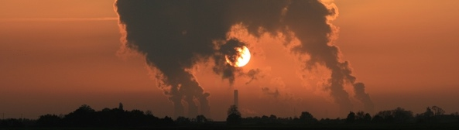
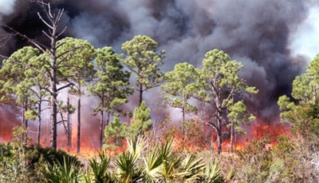
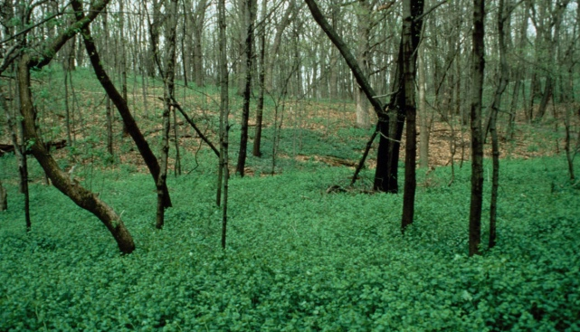
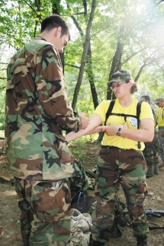
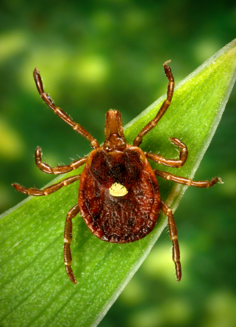
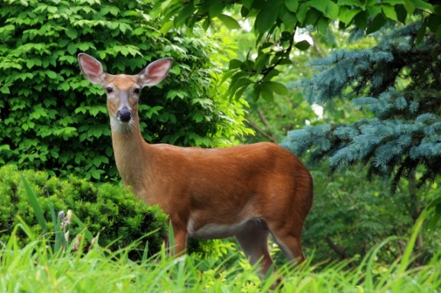
Technical Approach: Path Analysis
Direct and indirect effects of fire management on tick abundance
Initial results using field data
Calculated fire index combining fire return interval and time since last fire
Climate Change
Fire Management
Vegetation
HumanHealth
TBD Risk
Wildlife Abundance

Slide 19
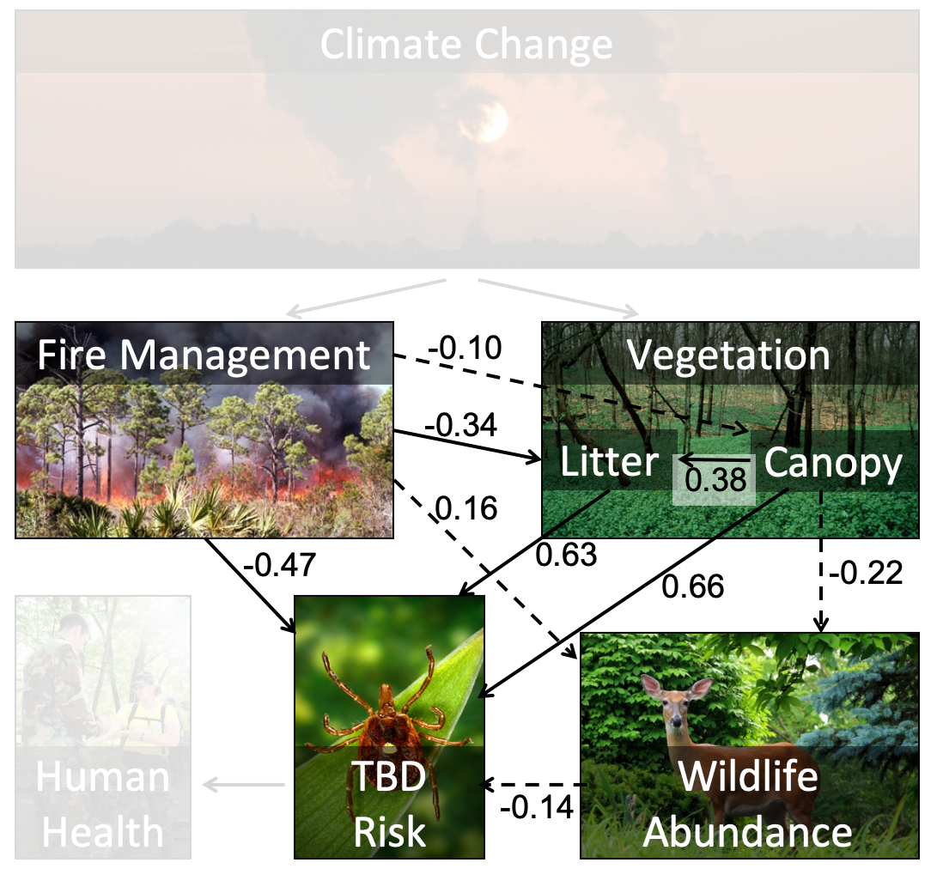
Results: Path analysis
Frequent and recent fire lowers tick abundance
The total fire effect works through the effect on litter cover
There was no detectable influence of host abundance
Effects on tick abundance
Variables | Direct | Indirect | Total
Fire index | -0.47 | -0.21 | -0.68
Litter cover | 0.63 | - | 0.63
Tree canopy cover | 0.66 | 0.24 | 0.90
Host abundance | - | - | -
Notes:
These are early path model results. Coefficients are standardized so relative effects can be interpreted
Dashed lines are non-significant paths, coefficients aren’t interpreted. Perhaps the most interesting lack of relationship being between host abundance and tick abundance.
The fire index combines the fire return interval and time since last fire; the direct effect of fire on tick abundance is stronger than the indirect effect via litter cover.
Further Work
Add abiotic/climate variables; we are working on calculating a set to test. Long-term averages (30-year and 15-year) of temperature and precipitation were not informative
Explore other vegetation measures
Develop competing models to compare

Slide 20
Action Items
Using the SERDP and ESTCP Management System (SEMS) as the source, list all SERDP Technical Committee/Program Office Action Items (verbatim) assigned over the past year (including the previous IPR) and any open Action Items from earlier years that have not been completed.
Indicate current status of each and what action is being or was taken to address the item.
If a white paper was written to address an Action Item, then summarize the contents of the white paper.
Notes:
Include only if required. This may require more than one slide.

Slide 21
Issues
Describe any unanticipated or unresolved issues that are affecting or could affect execution of the project.
Provide status on any unobligated funds.
Notes:
Include section only if required.

Slide 22
Transition Plan
Provide a list of any interim results or products that might be useful to an end-user right now
Identify how you will transition this research through Demonstration/Validation to an end-user. [Note: This can be through appropriate military Service- or ESTCP-funded programs or it may be through commercialization by a private industry partner.]
OR
Identify what you currently envision as the next steps for research beyond your currently funded SERDP project.
As appropriate, describe your efforts to include the user community in your research effort and/or to ensure user community “buy in” of the final results and products. If there are any regulatory issues associated with transitioning the technology, then these should be noted.
Notes:
This section should be limited to 1 to 3 slides.

Slide 23
Social Media Content
SERDP is expanding outreach through social media to improve technology transfer. Provide Program Office with project related information and high quality picture and/or video content that would be of interest to a broader audience and highlights accomplishments or events suitable for public release:
Examples include project websites, key tasks achieved (i.e., initiation of laboratory efforts), publications, news articles, courses or presentations, awards, photographs, videos
Include a 1-2 sentence summary and/or images (indicate whether the images in this presentation are publicly releasable) to highlight each proposed content item.
Provide a communications Point of Contact from your Organization and/or any existing Social Media accounts that we can tag when posting information about your project.
Email serdp-estcp.socialmedia@noblis.org for any social media related questions or to send social media videos/pictures currently or in the future.

Slide 24
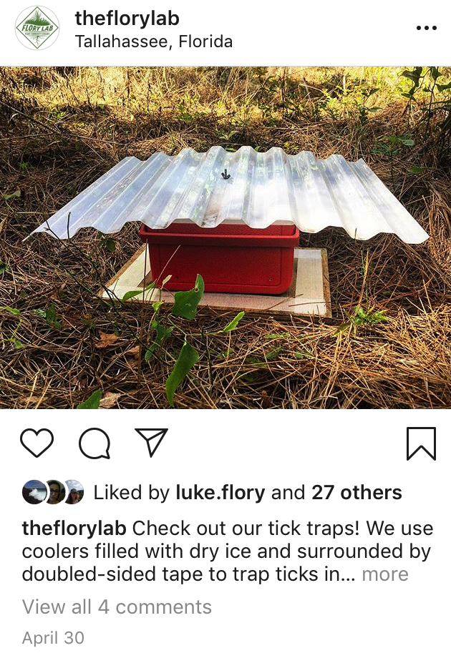
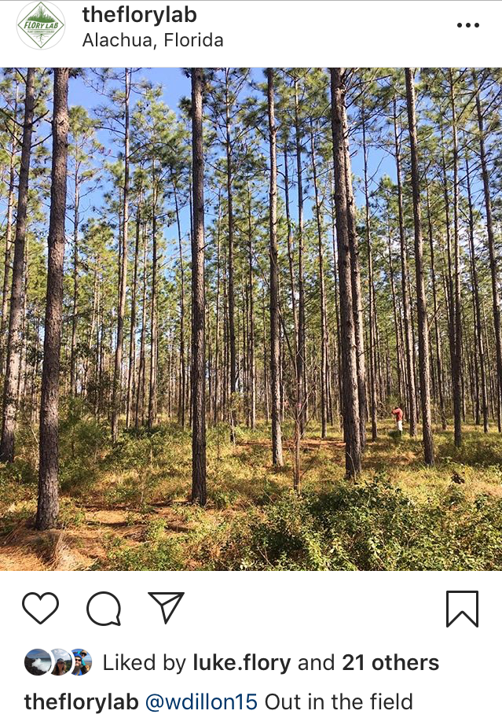
Social Media Outlets

Slide 25
Social Media Accounts
Follow our SERDP-ESTCP Accounts to see these posts and more!
SERDP-ESTCP
Twitter: @SERDP_ESTCP
Facebook: @SERDPESTCP
Linkedin: @SERDP & ESTCP
Google+: +SERDP and ESTCP
Notes:
For reference purposes – please delete slide from your presentation.

Slide 26
BACKUP MATERIAL

Slide 27
Acronyms and Symbols
Provide a listing of all acronyms and symbols used in the presentation, with definitions
Notes:
A symbol would be something like T_{s} standing for specimen temperature. Do not list common unit designations (e.g., mm, kW, lb) or elemental symbols from the periodic table.

Slide 28
Presentations
Current presentations:
Dillon, W., Hiatt, D., Gardner, A.M., Allan B., Dietze, M., and Flory S.L., August 2019 “Direct and indirect effects of fire management on tick abundance in the Southeast United States” Ecological Society of America (ESA) Annual Conference. Louisville, KY.
Hiatt, D., Dillon, W., Cabrera S., Gardner, A.M., Allan B., Dietze, M., and Flory S.L., August 2019. “Grass invasion enhances survival of a human disease vector by altering microclimate conditions” Ecological Society of America (ESA) Annual Conference. Louisville, KY.
Hiatt, D., Dillon, W., Cabrera S., Gardner, A.M., Allan B., Dietze, M., and Flory S.L., March 2019. “Grass invasion enhances survival disease vector through alteration of microclimate conditions” Florida Exotic Pest Plant Council (FLEPPC) Annual Symposium. Melbourne, FL

Slide 29
Publications
Current publications
Hiatt, D., Dillon, W., and Flory, S.L. (in prep). Experimental method for testing the effects of fuel structure on fire intensity. Submitted to Fire Ecology.
Hiatt, D., Dillon, W., Cabrera, S., Gardner, A.M., Allan, B., and Flory, S.L. (in prep). Grass invasion enhances survival of disease vector through alteration of microclimate conditions. To be submitted to Oecologia.

Slide 30
Financial Execution (Example, Please Update)
Proposed Start: May 2013
Contract Award/MIPR Receipt: September 2013
Proposed v. Actual Execution Delta: 475k
Contract End Date: September 19, 2016
Additional Funds Needed in Next Calendar Year:
Lead Org:
Co-Performer(s):
Execution Outlook:
Discuss future project execution
Contract Award or Receipt of MIPR
Values in k($)
Optional as a template to discuss financial issues; required if additional resources are being requested
Notes:
Please use the corresponding excel file to populate the Monthly chart; the Cumulative chart will be updated as the Monthly chart is populated.
The “Proposed” values in the chart should mirror what was included in the Revised Proposal, and potentially may mirror the current “Planned” amounts in SEMS.
The “Actual” values should mirror SEMS and begin once the Contract was awarded or MIPR received.
Multiple Performers and FYs Funding Increments should be aggregated in these charts, DO NOT create individual charts for each FY or by Performer unless of particular value for discussion (e.g. One Performer way ahead of others).
The “Additional Funds for the Next Calendar Year” should be based on the Increments proposed in the Revised Proposal and the current project execution.

